Slide 1
Chemical Equilibrium Systems
Collision Theory Review
Collision theory states that in order for a reaction to occur, three criteria must be met:
Reactant particles must collide
Reactant particles must collide with a certain minimum energy (activation energy, E­­_{a})
Reactant particles must collide with correct orientation

Slide 2
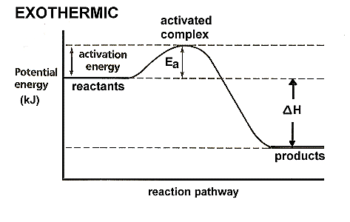
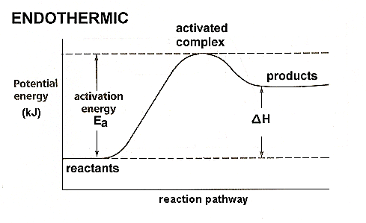
(Energy Diagrams 2012)

Slide 3
Factors that Affect Reaction Rates
Temperature
Increasing temperature increases the average kinetic energy of particles.
1. This increases the proportion of collisions that have sufficient kinetic energy to meet the activation energy needed for a successful collision which increases frequency of successful collisions and reaction rate.
2. To a much lesser degree, an increased kinetic energy means the particles move faster resulting in an increased frequency of successful collisions which also increases the reaction rate.

Slide 4
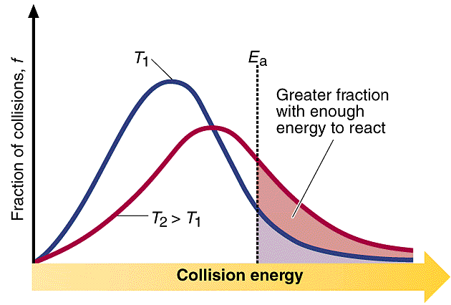
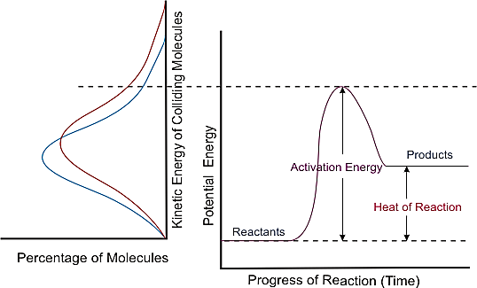
(Leutgens nd)
(CDLI 2007)

Slide 5
Concentration
Increasing concentration means decreased distance between particles (more particles in the same space) which increases the frequency of successful collisions which increases reaction rate.
Pressure
Increasing pressure (by reducing volume) decreases the distance between the particles which increases the frequency of successful collisions which increases reaction rate.

Slide 6
Sub-division
Increased surface area exposes more reactant particles for reaction which increases frequency of successful collisions which increases reaction rate.
Catalysts
Provide an alternate reaction pathway which has a lower E_{a}. This means a greater proportion of particles have E_{K} ≥ E_{a} which increases the frequency of successful collisions which increases reaction rate.

Slide 7
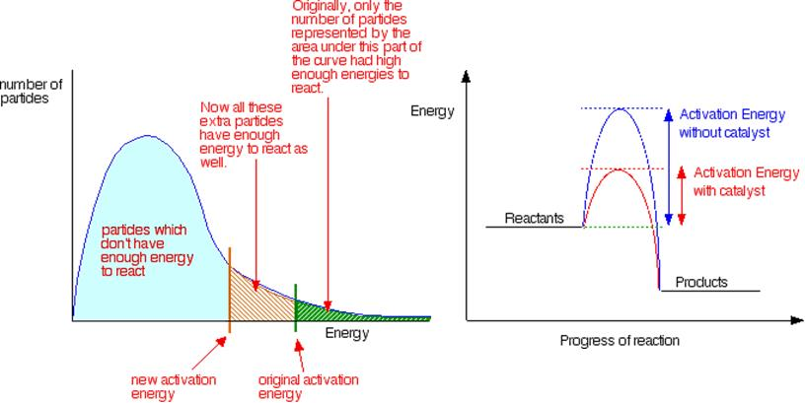
(Clark 2002)

Slide 8
Equilibrium
Many reactions (and processes) are reversible. Reversible reactions tend to have a low activation energy for both the forward and reverse reaction (as opposed to both having a high activation energy or either one of the forward or reverse reactions possessing a high activation energy). As the forward reaction proceeds, the concentration of products builds up which increases the rate of the reverse reaction.

Slide 9
Once the forward and reverse rates are equal and the concentrations of the products and reactants are constant, a reaction is said to be in equilibrium.
(NB: the concentrations of the reactants and the products are not necessarily equal).
Equilibrium is achieved in closed systems (i.e. systems where energy can enter or leave but matter cannot) and is denoted with the arrow symbol ⇌.
e.g. H_{2(g)} + I_{2(g)} ⇌ 2HI _{(g)}

Slide 10
A system at equilibrium is characterized by:
A constancy in macroscopic properties. These are the physical, measureable properties of matter. They can include colour, pressure, concentration, temperature, etc.
The forward and reverse rates being equal (the system is said to be in dynamic equilibrium).

Slide 11
Physical Systems

Slide 12
Vapour Pressure Equilibrium
In a closed system, some of the liquid evaporates to join the vapour phase. At the same time, some vapour particles condense to re-enter the liquid phase.
Eventually the rate of condensation will equal the rate of vaporization and equilibrium will be achieved.
e.g. H₂O_{(l)} ⇌ H₂O_{(g)}
The amount of liquid will remain constant as will the vapour pressure above the liquid (so long as no changes are made to the system).

Slide 13
What would happen to the system if the temperature of the system were raised?
More liquid particles have sufficient kinetic energy to leave the liquid phase and the rate of vaporization increases. Soon after (as there are more gaseous particles present), the rate of condensation increases until the rate of condensation equals the rate of vaporization and a new equilibrium is achieved. At this new equilibrium the volume of liquid will be less and the vapour pressure will be higher.

Slide 14
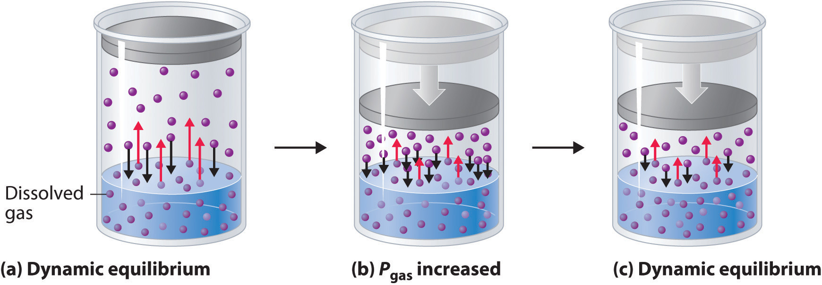
A system involving a pressure change.
(Larsen D nd)

Slide 15
Every liquid has a unique equilibrium vapour pressure at a specific temperature. The position of the equilibrium describes the extent to which the liquid is in the vapour phase.
The greater the vapour pressure, the more the equilibrium lies to the right. This means the more readily the liquid evaporates. In general, the weaker the intermolecular forces between the liquid particles, the greater the vapour pressure.

Slide 16
Solution Equilibrium
When a (soluble) solid is placed in a liquid, the solid begins to dissolve. As more solid is added and saturation is achieved, it continues to dissolve but at the same time, some of the dissolved particles crystallise to re-form solid.
At the point of saturation the rate of dissolution will equal the rate of crystallisation and equilibrium will be achieved.
The amount of solid will remain constant as will the concentration of the ions in solution (so long as no changes are made to the system).

Slide 17
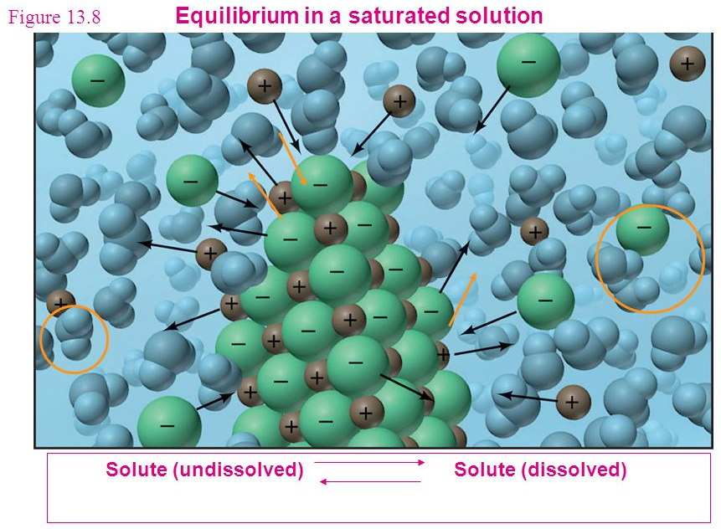
e.g. NaCl_{(s)} ⇌ Na⁺_{(aq)} + Cl‒_{(aq)}
(Marr 2006)

Slide 18
What would happen to the system if the temperature of the system were increased?
If the temperature is increased more solid particles will have sufficient energy to dissolve into the solution and the rate of dissolution increases. Soon after, the rate of crystallization increases until the rate of crystallization equals the rate of dissolution and a new equilibrium is established. At this new equilibrium, the amount of solid would be less and the concentration of the solution will be greater.

Slide 19
Chemical Systems
In chemical systems, the equilibrium in closed systems exists between the reactants and the products.
e.g. 2NO_{2(g)} ⇌ N₂O_{4(g)}
brown colourless
In an equilibrium system, the relationship between the concentration of reactants and products has been (experimentally) determined to be a constant at a specific temperature.

Slide 20
The equilibrium constant (or law) expression shows the relationship between the equilibrium concentration of the reactants and products and the equilibrium constant (K_{c}).
For the general equation:
aA_{(g)} + bB_{(g)} ⇌ cC_{(g)} + dD_{(g)}
it is given as:

Slide 21
It is important to note that only aqueous and gaseous species are included in the equilibrium constant expression as the concentrations of solids and liquids are said to be constant from one reaction to the next (concentration is said to be related to density and molar mass of which both remain constant).

Slide 22
No matter what the initial concentrations of the reactants or products, the value of the equilibrium constant will always be the same (provided it is measured under the same temperature conditions).
PCl_{3(g)} + Cl_{2(g)} ⇌ PCl_{5(g)}
 | [PCl₃] | [Cl₂] | [PCl₅] | [PCl₅]/([PCl₃][Cl₂])
Equilibrium (initial) | 0.80 | 1.20 | 2.40 | 2.50
Cl_{2(g)} added | 0.80 | 2.00 | 2.40 | 1.50
Equilibrium (new) | 0.585 | 1.785 | 2.615 | 2.50

Slide 23
Example: Write the equilibrium constant expressions for the following situations:
3O_{2(g)} ⇌ 2O_{3(g)}
HF_{(aq)} + H₂O_{(l)} ⇌ F‒_{(aq)} + H₃O⁺_{(aq)}
As₄O_{6(s)} + 6C_{(s)} ⇌ As_{4(g)} + 6CO_{(g)}
Pb²⁺_{(aq)} + 2Cl–_{(aq)} ⇌ PbCl_{2(s)}

Slide 24
The equilibrium constant gives an indication of the relative proportions of reactants and products.
Large values suggest that the products have a greater concentration than the reactants (i.e. the equilibrium favours the forward reaction/favours the products/lies to the right).
Small equilibrium constant values suggest that the reactants have a greater concentration than the products (ie the equilibrium favours the reverse reaction/favours the reactants/lies to the left).

Slide 25
Equilibrium constants close to one suggest concentrations of reactants and products are similar.
Example: The K_{c} values for the ionisation of two weak acids are given below. Which is the stronger acid and why?
CH₃COOH_{(aq)} + H₂O_{(l)} ⇌ CH₃COO–_{(aq)} + H₃O⁺_{(aq)}
K_{c} = 1.82 ×10⁻⁵
HCN_{(aq)} + H₂O_{(l)} ⇌ CN–_{(aq)} + H₃O⁺_{(aq)}
K_{c} = 6.23 ×10⁻¹⁰

Slide 26
CH₃COOH as it has the higher K_{c} value which indicates more products present at equilibrium. As acid strength is based on [H₃O⁺] in solution, this means CH₃COOH is stronger.
It is important to understand that the equilibrium constant gives no information about the rate of a reaction.

Slide 27
Le Châtelier’s Principle
Le Châtelier’s principle allows us to predict (and justify but not explain) the effect changes on a system at equilibrium will have. It can be stated as:
“If a system at equilibrium is subjected to a change in conditions, the system will re-establish equilibrium in such a way as to partially counteract the imposed change.”

Slide 28
Changes to a system at equilibrium can include changing the:
concentration of any one aqueous or gaseous species (by adding or removing it from the system)
concentration of multiple species in solution (by adding or removing the solvent (usually water))
total pressure of a gaseous system (by increasing or decreasing the volume of the system)
temperature of the system (by adding or removing heat from the system)

Slide 29
It is very important to remember that Le Châtelier’s principle
only predicts how a system will react to changes imposed. The principles of reaction rates and collision theory are used to explain the changes.
Changes to systems at equilibrium can be graphically presented in two ways:
Concentration-time graph – plots concentration of all gaseous and/or aqueous species as a function of time.
Reaction rate-time graph – plots the rate of the forward and reverse reactions.

Slide 30
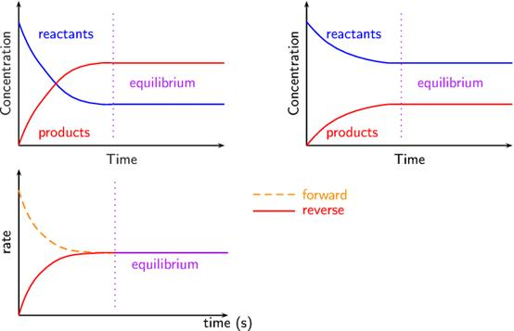
(Siyavula nd)

Slide 31
Concentration Changes
When the concentration of a particular species is changed (by addition or removal), Le Châtelier’s principle predicts how the system will react.
If a species’ concentration is decreased, the equilibrium will shift to try to increase the concentration of that particular species.
If a species’ concentration is increased, the equilibrium will shift to try to decrease the concentration of that particular species.

Slide 32
Using the example:
Cr₂O₇²⁻_{(aq)} + 2OH‒_{(aq)} ⇌ 2CrO₄²⁻_{(aq)} + H₂O_{(l)}
orange yellow
Draw a labelled concentration-time graph and a labelled reaction rate-time graph that shows the first equilibrium being achieved when a solution of potassium dichromate is added to a solution of sodium hydroxide.

Slide 33
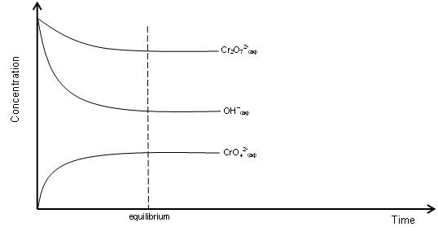

Slide 34
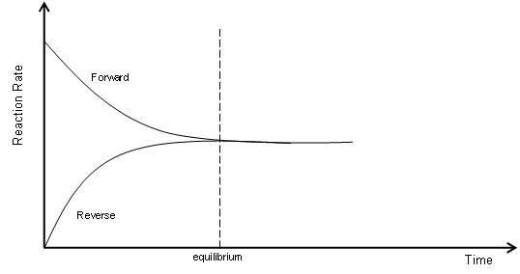

Slide 35
What would you observe as equilibrium is achieved?
An orange solution added to a colourless solution to become an orange/yellow solution.
Predict and justify the change in equilibrium if a small amount of potassium dichromate is added to the system at equilibrium.
The equilibrium will shift to counteract the added potassium dichromate. The forward reaction will be favoured which decreases the concentration of potassium dichromate and the equilibrium shifts right until a new equilibrium is established.

Slide 36
What would you observe?
An orange solution is added to an orange/yellow solution which then becomes more yellow.
Explain the change in equilibrium.
By adding more K₂Cr₂O₇ you are increasing [Cr₂O₇²⁻]. This increases the forward reaction rate (increased frequency of collisions) relative to the reverse reaction. After a time, the forward reaction rate begins to slow down as the reverse reaction rate increases until the rate of the forward and reverse reactions are equal (i.e. a new equilibrium is achieved).

Slide 37
On the previous concentration-time and reaction rate-time axes continue the diagrams so that they show the second equilibriums being achieved when extra potassium dichromate is added to the solution at equilibrium.

Slide 38
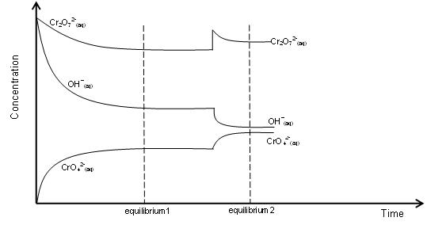

Slide 39
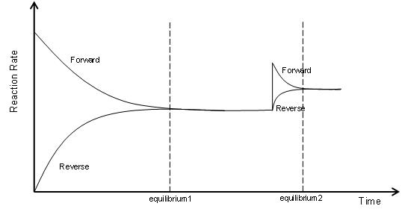
Redo this question if a small amount of concentrated hydrochloric acid was added to the system at initial equilibrium.

Slide 40
After the second equilibrium is established in both graphs, draw what would happen if a small amount of concentrated hydrochloric acid was added to the system at initial equilibrium.
Draw the final situation given above on two new sets of concentration-time and reaction rate-time axes if you were beginning at equilibrium.

Slide 41
The concentration of all species in a system can be manipulated by adding or evaporating the solvent (usually water).
When adding water to the entire system, this has the effect of reducing the concentration of all species. This will increase the distance between all the particles which reduces the frequency of collisions and so reduces the rate of both the forward and reverse reactions. The rate of the reaction that uses up the most particles will be decreased the most (based on relative proportions) and so the reaction that produces more particles will occur at a greater rate (be favoured) until equilibrium is re-established.

Slide 42
When removing water from the entire system (i.e. evaporation), this has the effect of increasing the concentration of all species. This will decrease the distance between all the particles which increases the frequency of collisions and so increases the rate of both the forward and reverse reactions. The rate of the reaction that uses up the most particles will be increased the most (based on relative proportions) and so the reaction that produces less particles will occur at a greater rate (be favoured) until equilibrium is re-established.
(Remember that the side with the most particles will always be affected the most)

Slide 43
e.g. Co(H₂O)₆²⁺_{(aq)} + 4Cl‒_{(aq)} ⇌ CoCl₄²⁻_{(aq)} + 6H₂O_{(l)}
pink blue
Using the system above, predict and justify which way the equilibrium will shift (if at all) when water is added to the system.
Adding water will decrease the concentration of all species. The equilibrium will shift to partially counteract the imposed change and favour the reverse reaction which increases the concentration of species as it produces more particles. The equilibrium shifts left until a new equilibrium is established.

Slide 44
Give the observations for this change.
Colourless solution added to pink/blue solution. Solution becomes more pink.

Slide 45
Explain this change in equilibrium.
Adding water reduces the concentration of all species. This will increase the distance between all the particles which reduces the frequency of collisions and so reduces the rate of both the forward and reverse reactions. The rate of the forward reaction that uses up the most particles will be decreased the most (based on relative proportions) and so the equilibrium shifts left until equilibrium is re-established.

Slide 46
Total Pressure Changes (ie Changes in Volume of Gaseous Systems)
When the total pressure of a system is changed (by manipulating volume), Le Châtelier’s principle predicts how the system will react.
If the volume of the system is increased, this decreases the total pressure. The equilibrium will shift to try to increase the total pressure again which means it will favour the side with the greater number of particles (increasing the total number of moles of gaseous particles in the system).

Slide 47
If both sides of the equilibrium have the same number of relative particles, there is no change in the position of the equilibrium.
When increasing the volume of the system (i.e. decreasing the pressure of the system), this will increase the distance between all the particles which reduces the frequency of collisions and so reduces the rate of both the forward and reverse reactions. The rate of the reaction that uses up the most particles will be decreased the most (based on relative proportions) and so the reaction that produces more particles will occur at a greater rate (be favoured) until equilibrium is re-established.

Slide 48
When decreasing the volume of the system (i.e. increasing the pressure of the system), this will decrease the distance between all the particles which increases the frequency of collisions and so increases the rate of both the forward and reverse reactions. The rate of the reaction that uses up the most particles will be increased the most (based on relative proportions) and so the reaction that produces less particles will occur at a greater rate (be favoured) until equilibrium is re-established.
(Remember that the side with the most particles will always be affected the most)

Slide 49
Using the example:
N_{2(g)} + 3H_{2(g)} ⇌ 2NH_{3(g)}
Draw a labelled concentration-time graph and a labelled reaction rate-time graph that shows the first equilibrium being achieved when gaseous nitrogen and hydrogen are placed in a closed cylinder with a variable volume.

Slide 50
What would you observe as equilibrium is achieved?
No observable change
(all gases are colourless and if it is closed, assume formation of pungent ammonia gas cannot be detected).

Slide 51
Predict and justify the change in equilibrium if the total volume of the cylinder is increased.
As volume increases, total pressure decreases.
According to Le Châtelier’s the system will react to partially counteract the change. As such, decreasing the pressure favours the reverse reaction which increases the pressure, as it produces more particles, and the equilibrium shifts left until a new equilibrium is established.

Slide 52
Explain the change in equilibrium.
Increasing the volume of the system increases the distance between all particles. This reduces the frequency of collisions which decreases the rate of both the forward and reverse reactions. As the ratio of reactants to products is 4:2, the rate of the forward reaction (which uses up the most particles) will decrease more than the reverse reaction. The reverse reaction occurs at a greater rate relative to the forward reaction and the equilibrium shifts left until a new equilibrium is established.

Slide 53
On the previous concentration-time and reaction rate-time axes continue the diagrams so that they show the second equilibrium being achieved when the volume of the system at equilibrium is increased.
NB: When the volume is increased, the concentration (or partial pressure) of each species will change relative to the others.
Similarly, when it returns to equilibrium, although they approach their original concentrations, the final concentrations will never equal (or go above or below) the initial concentrations at equilibrium.

Slide 54
Temperature Changes
When the temperature of a system is changed (by heating or cooling), Le Châtelier’s principle predicts how the system will react (the heat of reaction (ΔH) is needed).
According to Le Châtelier, the system will react to partially counteract the change.
Increasing the temperature of the system will favour the endothermic reaction as it decreases the temperature.
Decreasing the temperature of the system will favour the exothermic reaction as it increases the temperature.

Slide 55
Changes in equilibrium due to temperature changes can be explained by the changes in the rates of the forward and reverse reactions and can be represented on energy profile diagrams.

Slide 56
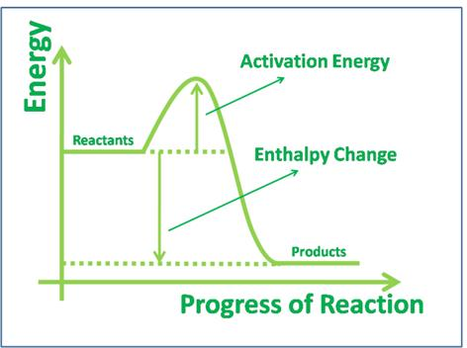
For example: 2SO_{2(g)} + O_{2(g)} ⇌ 2SO_{3(g)}
ΔH = ‒198 kJ

Slide 57
Adding heat will increase both forward and reverse reactions but it will favour the endothermic reaction (in this case the reverse reaction) to a greater extent.
More of the added heat is able to be absorbed by the endothermic reaction, reducing the temperature of the system.

Slide 58
Using the example:
I_{2(g)} + H_{2(g)} ⇌ 2HI_{(g)}
purple ΔH = +26 kJ
Draw a labelled concentration-time graph and a labelled reaction rate-time graph that shows the first equilibrium being achieved when gaseous iodine and hydrogen are placed in a closed cylinder.

Slide 59
What would you observe as equilibrium is achieved?
Purple gas added to a colourless, odourless gas which becomes a paler purple gas.
Predict and justify the change in equilibrium if the cylinder is cooled.
According to Le Châtelier, the system will react to partially counteract the change. As such, decreasing the temperature of the system will favour the reverse exothermic reaction as it increases the temperature and the equilibrium shifts left until a new equilibrium is established.

Slide 60
What would you observe?
The pale purple gas becomes a darker purple.
Explain the change in equilibrium.
Cooling the system (decreasing the temperature) decreases the average kinetic energy of the particles which means fewer collisions have enough energy to meet the activation energy required. This decreases the frequency of successful collisions.
Also, as particles are moving slower, the frequency of collisions decreases.

Slide 61
Both the rate of forward and reverse reactions decrease but the rate of the endothermic reaction, which in this case is the forward reaction, decreases more.
This means the rate of the reverse reaction is greater relative to the forward and the equilibrium shifts left until a new equilibrium is established.

Slide 62
On the previous concentration-time and reaction rate-time axes continue the diagrams so that they show the second equilibrium being achieved when the system at equilibrium is cooled.
Catalyst Changes
Although adding a catalyst increases the rate at which equilibrium is achieved, as it increases both the forward and reverse reactions, it has no effect on the position of the equilibrium.

Slide 63
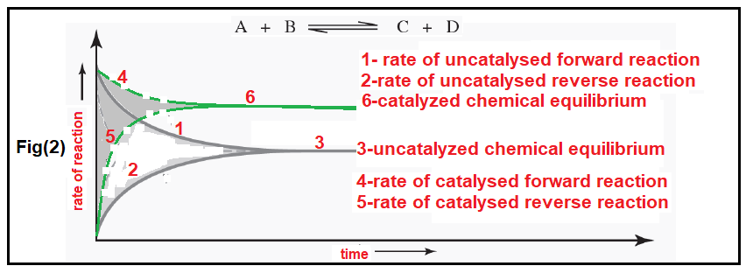
(NA, 2017)
This reaction rate-time diagram can also be used to show the effect of increasing temperature, concentration and/or pressure.

Slide 64
Changes in Conditions and Equilibrium Constants
Manipulating pressure (total or partial), concentrations and/or the addition of catalysts does not impact the equilibrium constant.
Only temperature will change an equilibrium constant.

Slide 65
If the forward reaction is endothermic, an increase in temperature will cause an increase in the equilibrium constant.
Conversely, an increase in temperature will cause a decrease in the equilibrium constant if the forward reaction is exothermic (and vice versa).

Slide 66
Ocean Equilibria and Atmospheric Carbon Dioxide
The burning of excessive fossil fuels in the recent past has seen atmospheric carbon dioxide levels increase steadily since the 1940s.
This is problematic on a number of major fronts but particularly as
carbon dioxide is a greenhouse gas and it is slightly soluble in our oceans (which act as carbon sinks, absorbing roughly a third of the Earth’s anthropogenic (human produced) atmospheric carbon dioxide).

Slide 67
With rising global temperatures come rising ocean temperatures. This can have great impact on all manner of marine life.
Coral is particularly impacted as a lot of corals rely on a symbiotic relationship with an algae (zooxanthellae) to sustain their life. Sometimes when coral become stressed (as can be the case with rising oceanic temperatures) they expel the algae. If the algae do not return, the coral can become white in colour (bleached) and may eventually die.

Slide 68
The ocean acts as a sink for some of the atmospheric carbon dioxide through the following equilibrium:
CO_{2(g, atmosphere)} ⇌ CO_{2(aq, ocean)}
Some of the dissolved CO₂ can then react with water to produce carbonic acid (H₂CO₃ – a weak acid) through the following equilibrium:
CO_{2(aq, ocean)} + H₂O_{(l)} ⇌ H₂CO_{3(aq)}

Slide 69
As carbonic acid is a weak acid, it partially ionises to produce hydrogen (or hydronium) ions according to the equilibrium:
H₂CO_{3(aq)} + H₂O_{(l)} ⇌ HCO₃‒_{(aq)} + H₃O⁺_{(aq)}
Furthermore, the hydrogencarbonate ion can partially ionise to produce more hydronium ion according to the equilibrium:
HCO₃‒_{(aq)} + H₂O_{(l)} ⇌ CO₃^{2‒}_{(aq)} + H₃O⁺_{(aq)}

Slide 70
The hydronium ion produced can decrease the pH of the ocean which can increase the dissolving of solid calcium carbonate (found in calcifying organisms that use calcium carbonate in their shells and skeletons) through the following equilibrium:
CaCO_{3(s)} + 2H₃O⁺_{(aq)} ⇌ Ca²⁺_{(aq)} + CO_{2(g)} + 3H₂O_{(l)}
(This weakens shells/exoskeletons)

Slide 71
Additionally, the free carbonate ions in ocean water that calcifying species use to produce their shells or skeletons can be taken up by the excess hydronium ions in the water according to the equilibrium:
CO₃^{2‒}_{(aq)} + H₃O⁺_{(aq)} ⇌ HCO₃‒_{(aq)} + H₂O_{(l)}
(CO₃^{2‒}_{(aq)} comes from the dissolving of very slightly soluble CaCO₃:
CaCO_{3(s)} ⇌ Ca²⁺_{(aq)} + CO₃^{2‒}_{( aq)})
Scientific research on the impacts of ocean acidification on marine organisms and ecosystems is still very much in its infancy.

Slide 72
It is undeniable, however that we need to look to ways of reducing the amount of carbon dioxide we are producing through the use and reliance on fossil fuels.
Towards this end, the ultimate goal of the United Nations Kyoto Protocol, Intergovernmental Panel on Climate Change and all affiliated bodies is to reduce greenhouse gas concentrations in the atmosphere at a level that would prevent dangerous anthropogenic interference with the climate system.

Slide 73
Bibliography
CDLI. 2007. "Factors Affecting Reaction Rates." CDLI. Accessed July 8, 2015. https://www.cdli.ca/sampleResources/chem3202/unit01_org01_ilo03/b_activity.html.
Clark, J. 2002. "The Effect of Catalysts on Reaction Rate." Chemguide. Accessed July 8, 2015. http://www.chemguide.co.uk/physical/basicrates/catalyst.html.
Elhosiny, E. nd. "Equilibrium." Pintrest. Accessed December 7, 2015. https://www.pinterest.com/emanelhosiny/equilibrium/.
2012. "Energy Diagrams." C&J&S&B's Chemistry Class. February 1. Accessed December 7, 2015. http://chemistrywithelevens.blogspot.com.au/2012/02/energy-diagrams.html.
Hallatt, A. 2013. "By Request: A Cartoon on Ocean Acidification ." Alex Hallatt's Arctic Circle. September 27. Accessed December 7, 2015. http://arcticcirclecartoons.com/2013/09/27/by-request-a-cartoon-on-ocean-acidification/.
Kimbrough, S. nd. "C Equilibrium." Pintrest. Accessed December 7, 2015. https://www.pinterest.com/babybananies/c-equilibrium/.
Luetgens, D. nd. "Temperature and Reaction Rate." Explore, Experiment, Explain: Science An Excellent Adventure. Accessed July 8, 2015. http://dluetgens.com/temp_and_rxn_rate.html.
Marr, K. 2006. "Chapter 13 Properties of Solutions." Slide Player. Accessed January 18, 2016. http://slideplayer.com/slide/5244321/.
NA. 2014. "Chemsirty Cat Meme Generator." Pics & photos. Accessed February 26, 2015. http://funny-pictures.picphotos.net/chemistry-cat-meme-generator-diy-lol510/assets.diylol.com*hfs*6f8*5a9*51e*resized*chemistry-cat-meme-generator-a-covalent-bond-yells-at-an-ionic-bond-didn-t-anybody-ever-teach-you-to-share-3ad3fd.jpg/.
—. 2012. "Energy Diagrams." C&J&S&B's Class Chemistry. February 1. Accessed July 8, 2015. http://chemistrywithelevens.blogspot.com.au/2012/02/energy-diagrams.html.
—. 2017. Which Diagram Shows The Effect of Catalysis On Chemical Equilibrium? November. Accessed August 24, 2020. https://chemistry.stackexchange.com/questions/84889/which-diagram-shows-the-effect-of-catalysis-on-chemical-equilibrium.
—. nd. "Why is an Enzyme Called a Lock and Key Model." Answers. Accessed July 8, 2015. http://www.answers.com/Q/Why_is_an_enzyme_called_lock_and_key_model.
Rogers, E, I Stovall, L Jones, R Chabay, and E Kean. 2000. "Physical Properties of Liquids." Fundamentals of Chemistry. Accessed January 18, 2016. http://www.chem.wisc.edu/deptfiles/genchem/sstutorial/FunChem.htm.
Siyavula. nd. "Le Chatelier's Principle." Everything Maths and Science. Accessed January 18, 2016. http://www.everythingmaths.co.za/science/grade-12/08-chemical-equilibrium/08-chemical-equilibrium-03.cnxmlplus.
Skelly, D. nd. "Chemistry AS Level." Freezing Blue. Accessed January 18, 2016. http://www.freezingblue.com/flashcards/print_preview.cgi?cardsetID=260199.

